Slide 1
MongoDB aggregation pipeline

Slide 2
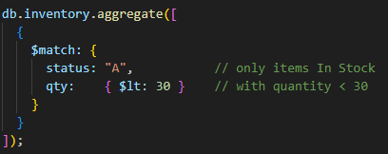
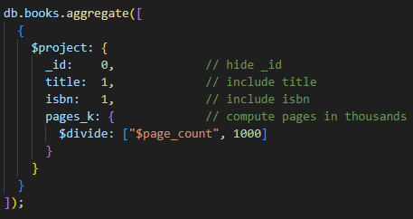
Stages
$match
$project

Slide 3

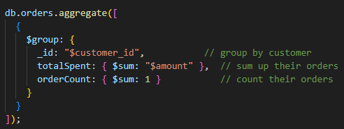
Stages
$unwind
$group

Slide 4
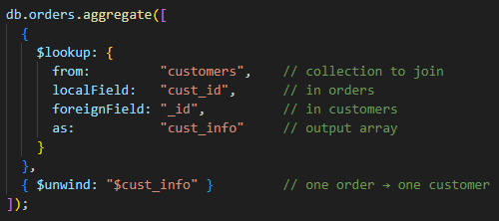
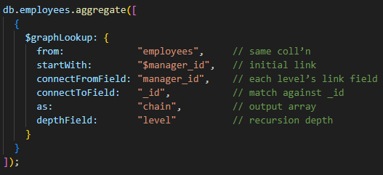
Stages
$lookup
$graphLookup

Slide 5
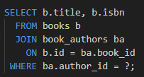
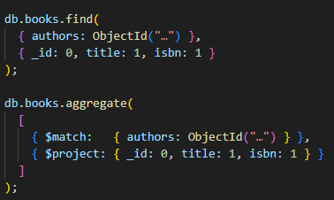
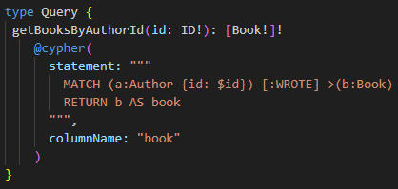
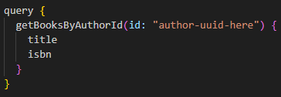
Comparing Selected Queries across Assignments
SQL
MongoDB
GraphQL/Neo4j

Slide 6
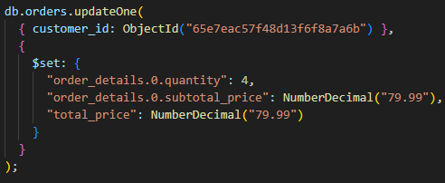
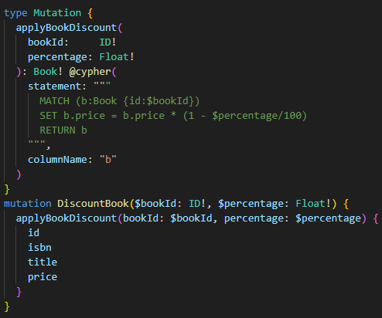
Comparing Data Modification Document vs. Graph
Update

Slide 7

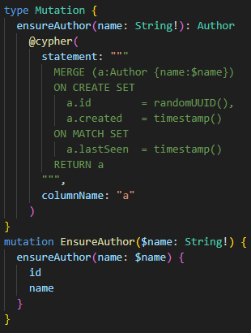
Comparing Data Modification Document vs. Graph
Upsert

Slide 8

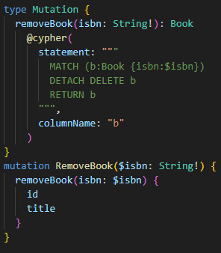
Comparing Data Modification Document vs. Graph
Delete

Slide 9
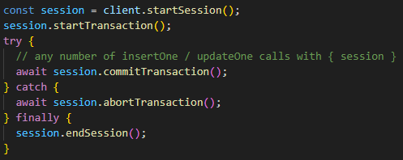
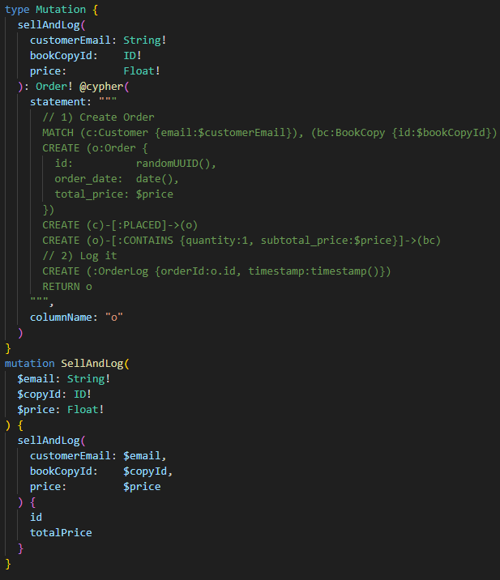
Comparing Data Modification Document vs. Graph
Transactions

Slide 10
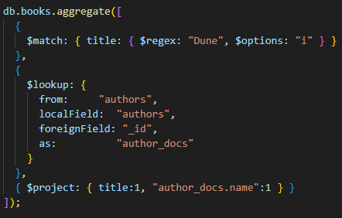
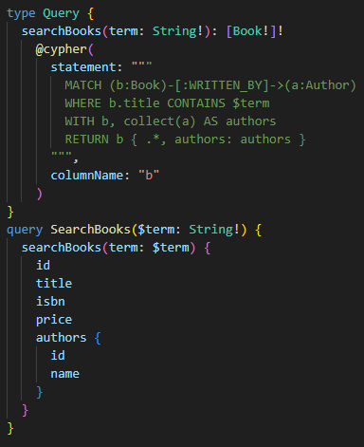
Comparing Data Modification Document vs. Graph
Fetch related data: Separate vs. Pattern

Slide 11

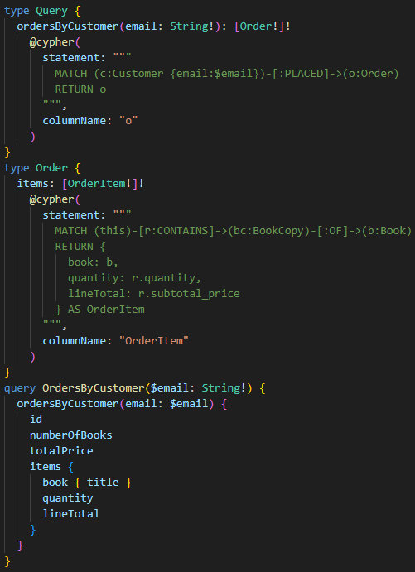
Comparing Data Modification Document vs. Graph
Embedded vs. Separate

Slide 12
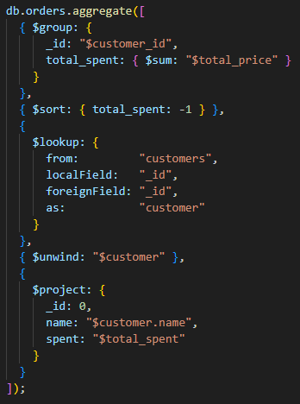
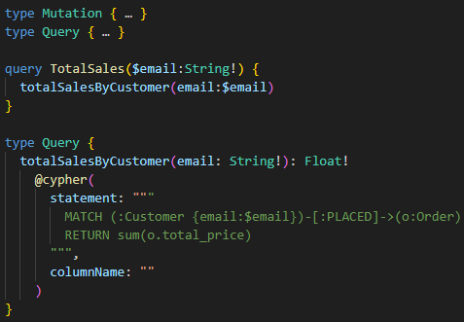
Comparing Data Modification Document vs. Graph
Declarative DSL

